Slide 1
SPOUG Flow Advanced workshop
Martin Boejstrup
Senior Premier Field Engineer
maboej@microsoft.com

Slide 3
Prep
Get Visual Studio Code - https://code.visualstudio.com/
Create a teamsite:
Create new list – name: “Largelist”
Add a extra column – Name : “Variant” type: “string”
Samples: https://aka.ms/spoug

Slide 4
Topics
Prep
SharePoint – Create 100 items -> 1000 items -> 6000 items
Good naming practice: names, description and comments
Peek code
Conditional Trigger – SharePoint and HTTP request
Speed your flow up – Select and Filter
SharePoint - Get more than 5000 items
Error handling
Optional values
Working with Microsoft Graph

Slide 5
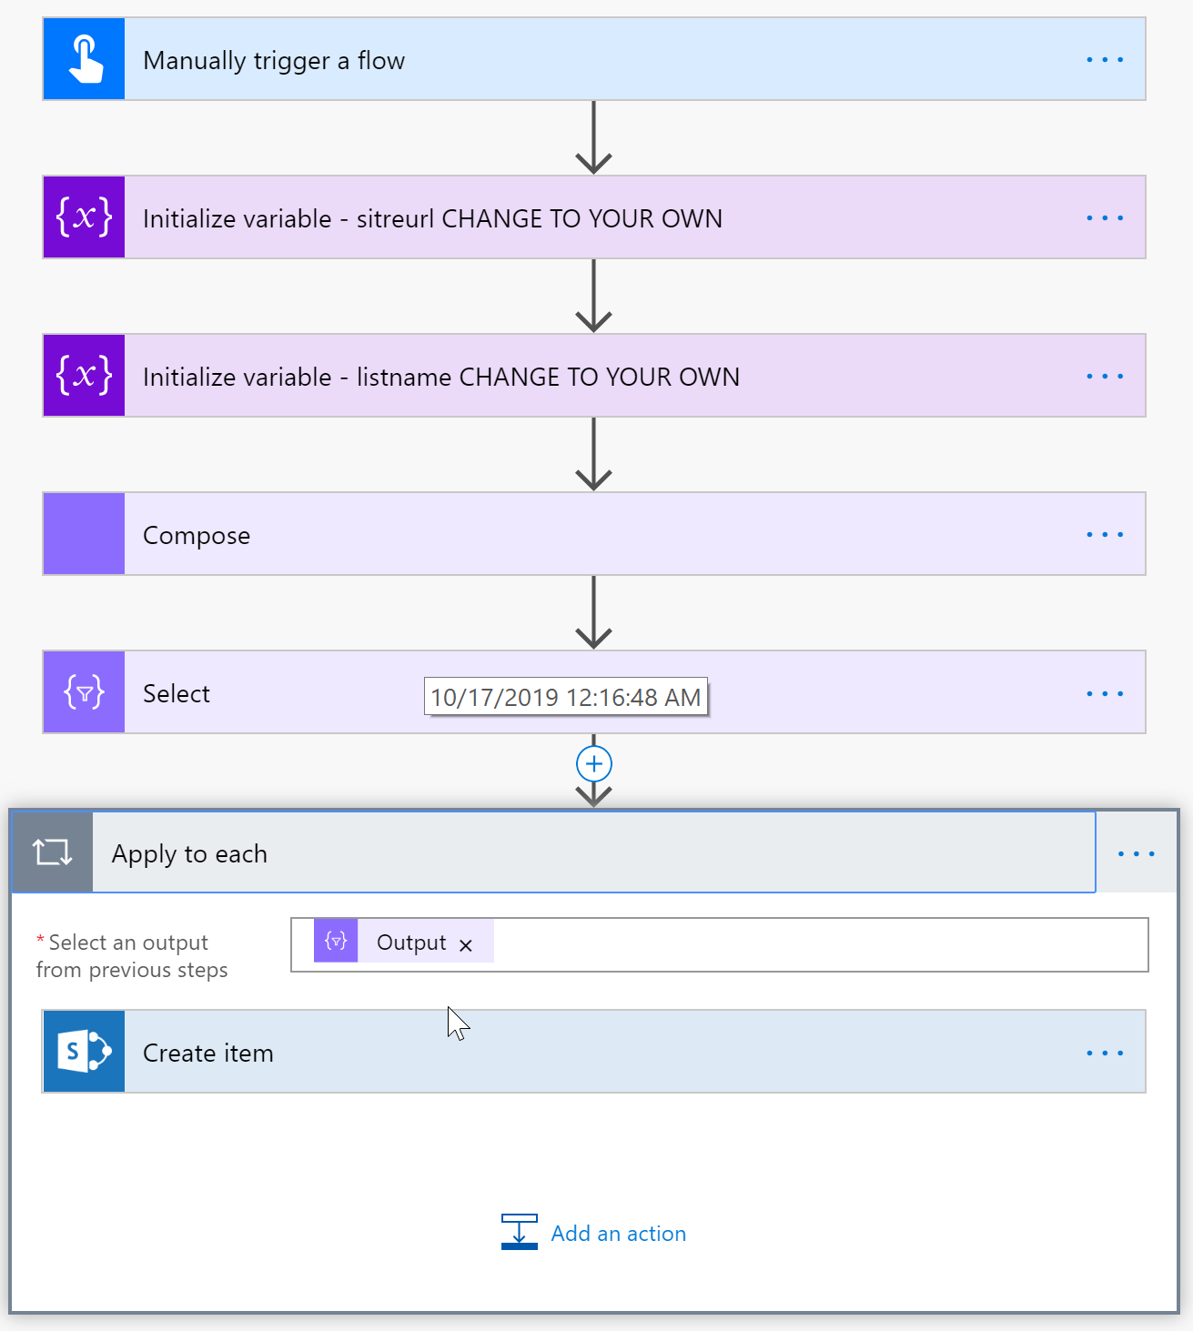
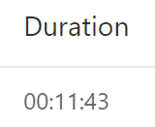
SharePoint – Create 100 items
Sample flow: “Flow Training Create 100 items sharepoint

Slide 6
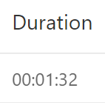
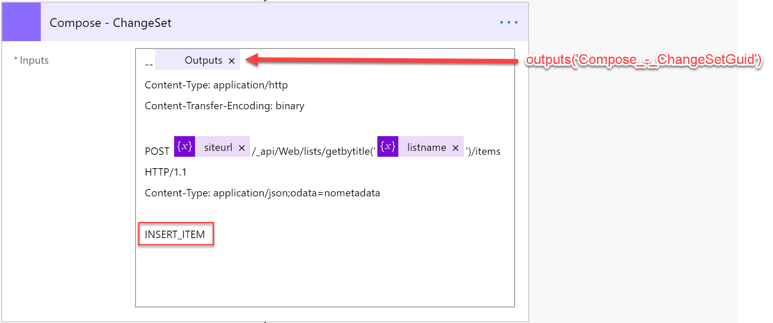
SharePoint – Create 1000 items (Batch)
Sample flow: “Flow Training Create 1000 items sharepoint bacth”

Slide 7
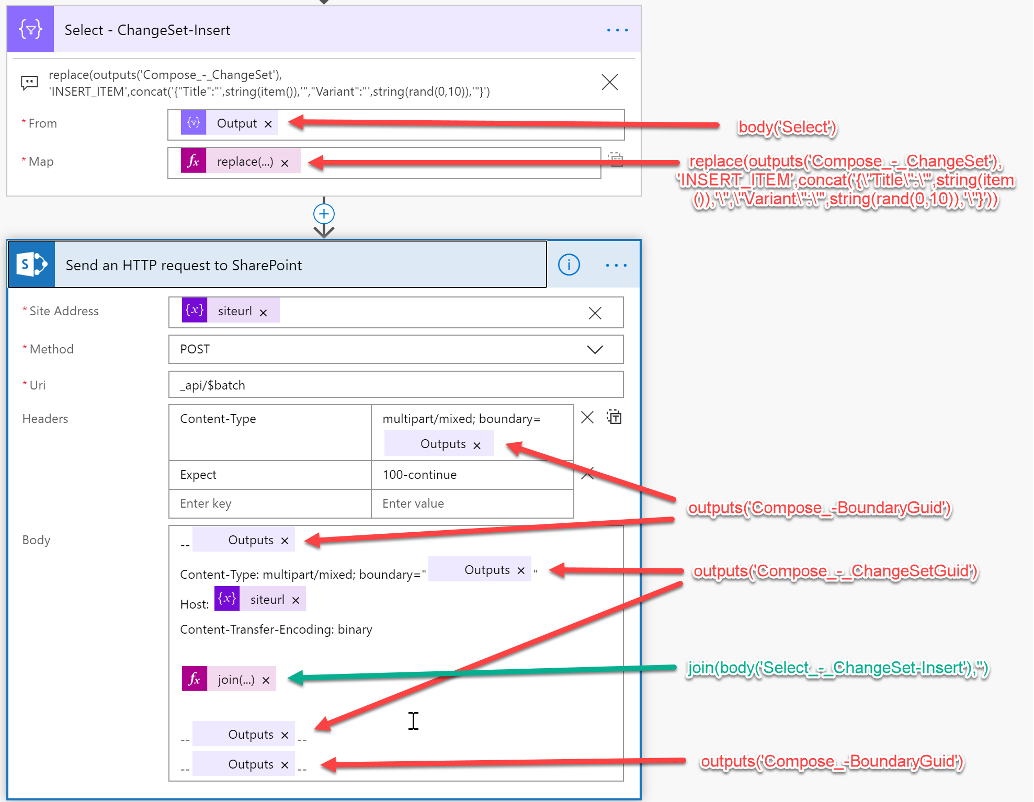
SharePoint – Create 1000 items (Batch)
Sample flow: “Flow Training : Error Handling”

Slide 8
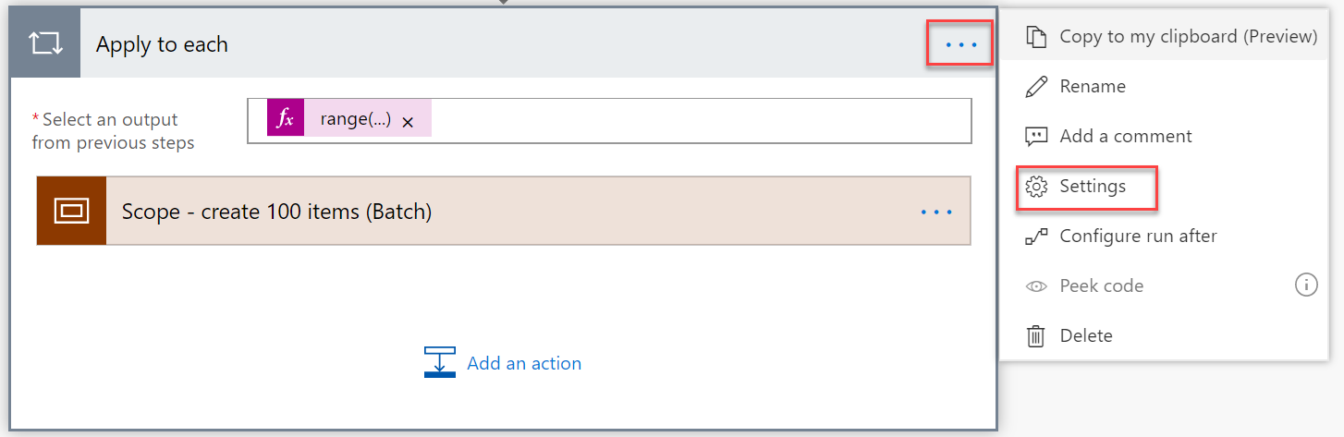
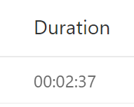
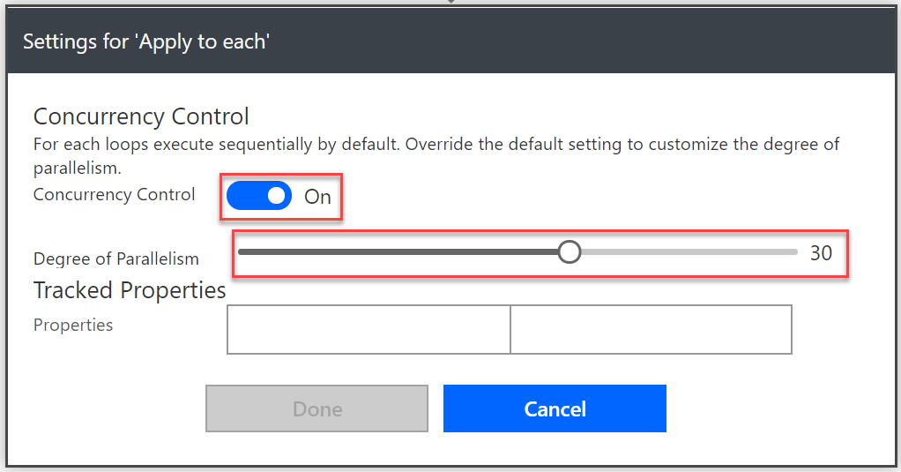
SharePoint – Create 60 x 100 items Batch and Apply to Each (Concurrency)
Sample flow: “Flow Training Create 60x100 items sharepoint bacth”

Slide 9
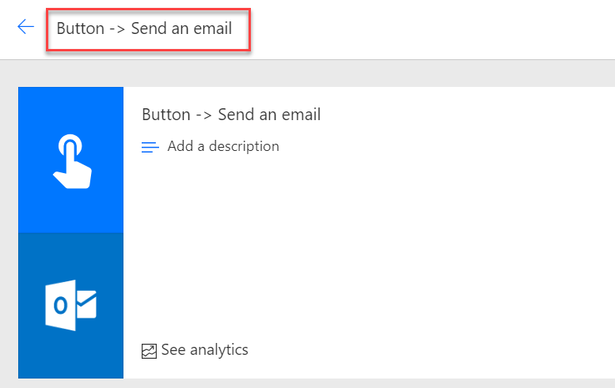
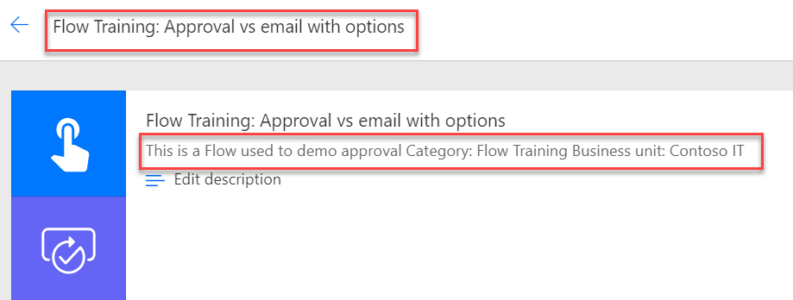
Flow name and description
BAD NAME
GOOD NAME
Description missing
Good Description

Slide 10
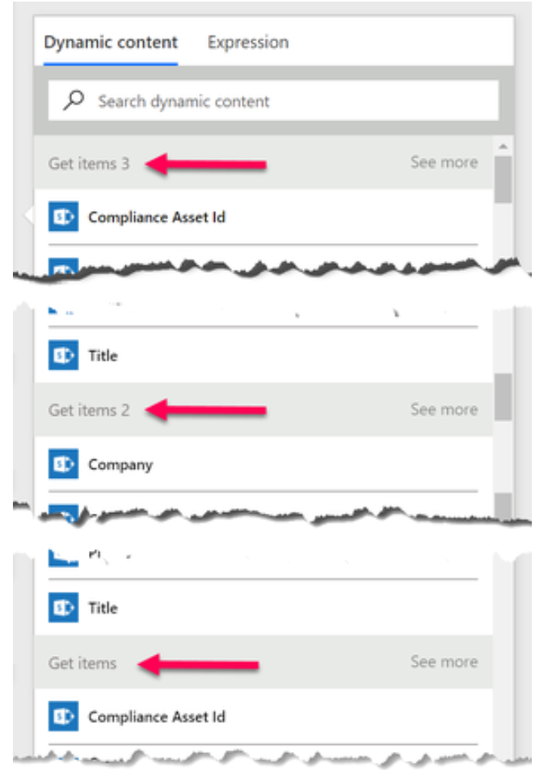
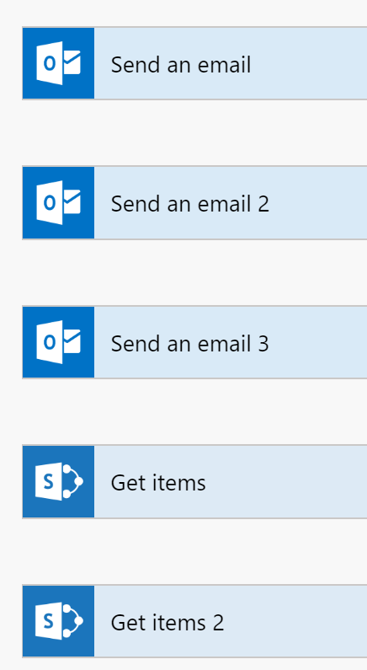
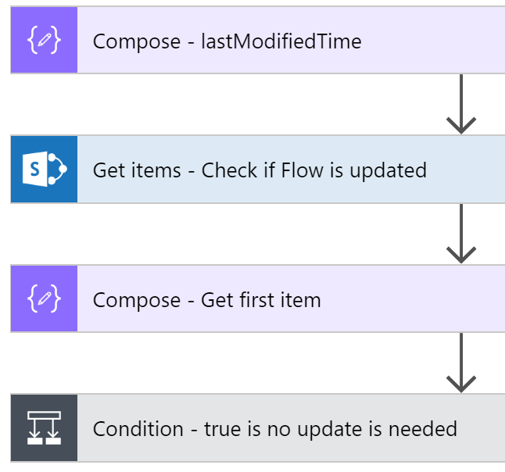
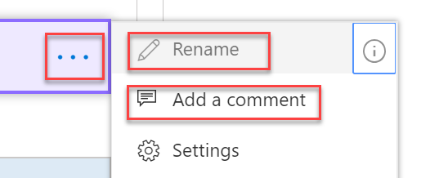
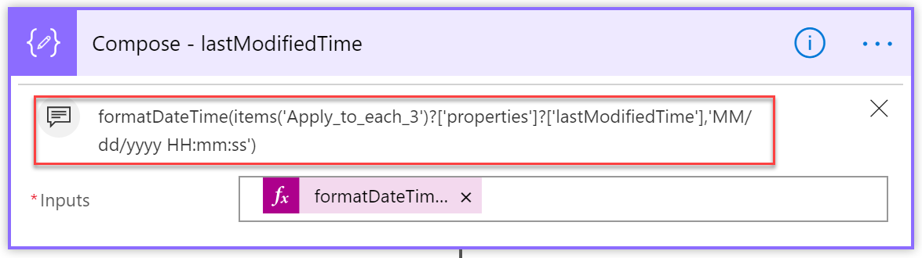
Action naming
GOOD NAME
BAD NAME
Use comments

Slide 11
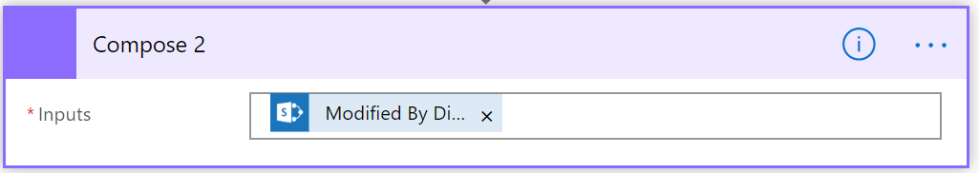
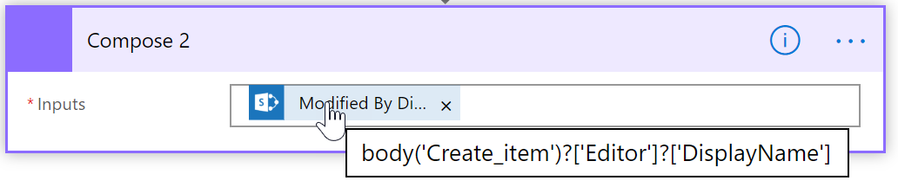
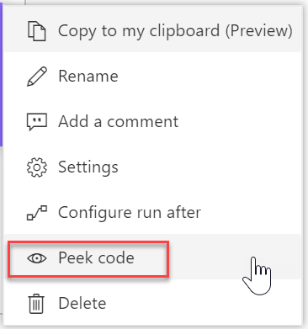
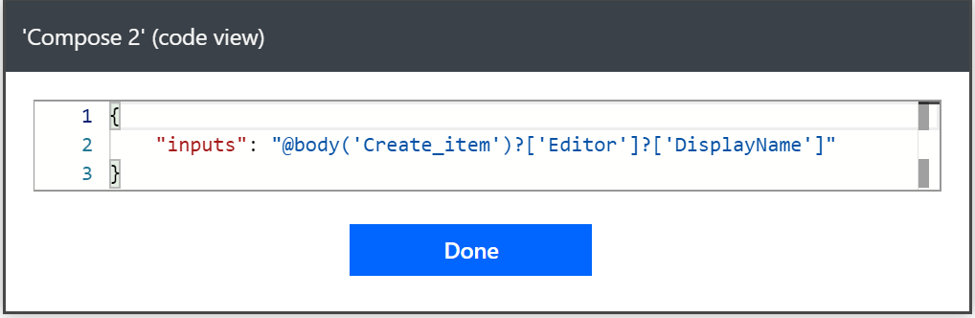
Peek code

Slide 12
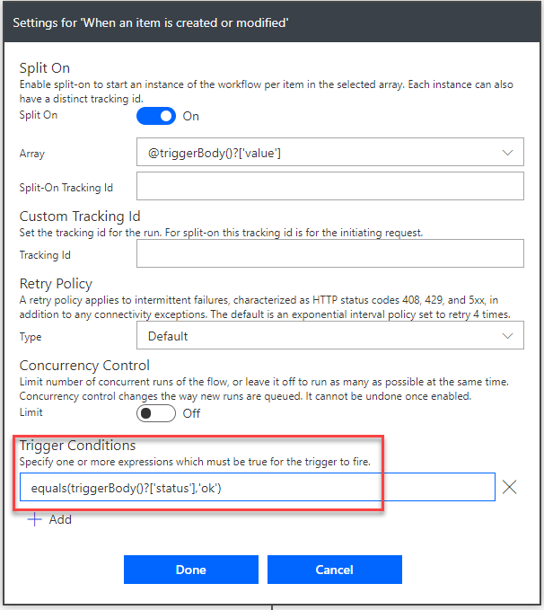
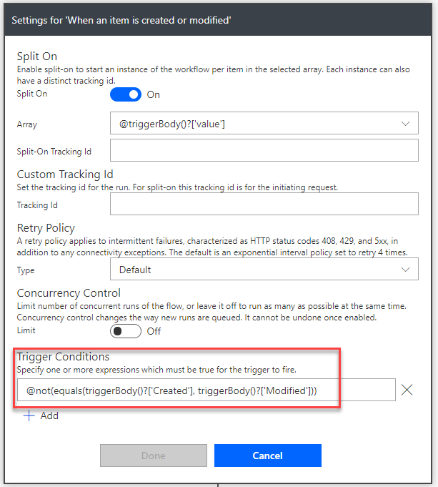
Conditional Trigger - SharePoint
Sample flow: “Flow Training Conditional Trigger” and “Flow Training Conditional Trigger Only modified”

Slide 13
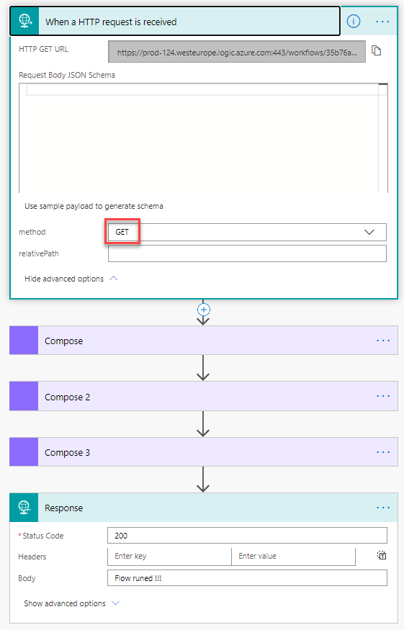
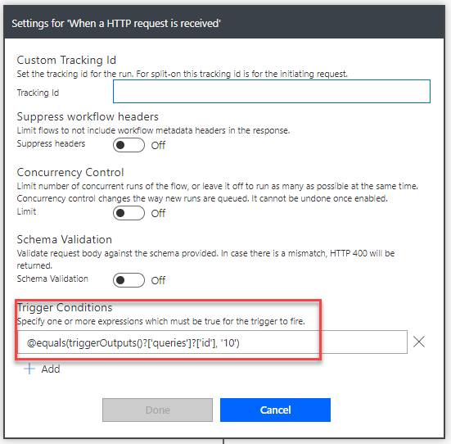
Conditional Trigger – HTTP Request
Sample flow: “Flow Training HTTP request with Conditional Trigger”

Slide 14
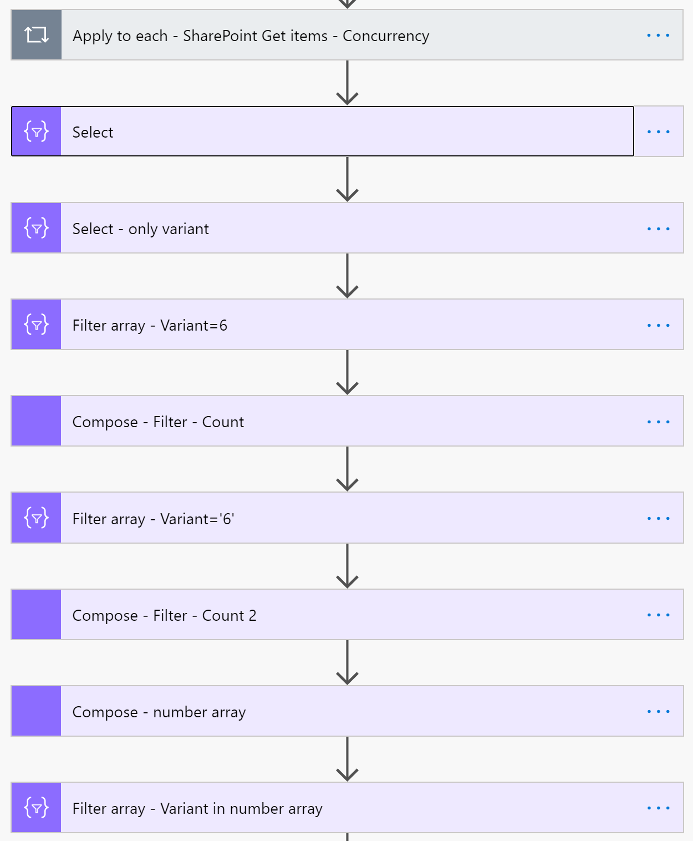
Speed your flow up – Select and Filter
Sample flow: “Flow Training: Select and filter.zip”

Slide 15
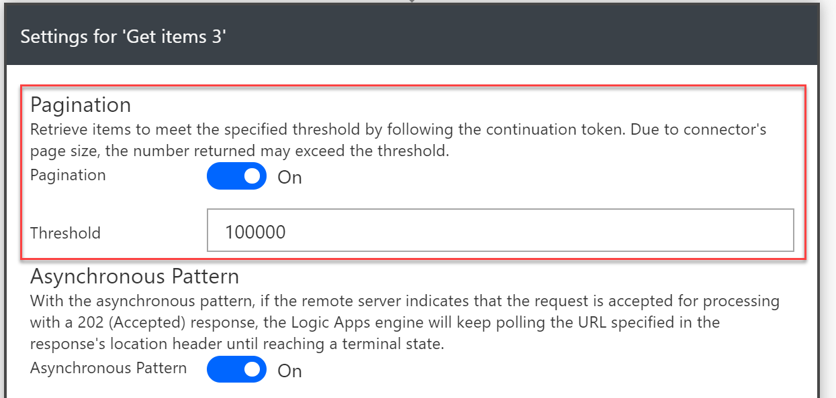
SharePoint - Get more than 5000 items
Sample flow: “Flow Training get all items over 5000”

Slide 16
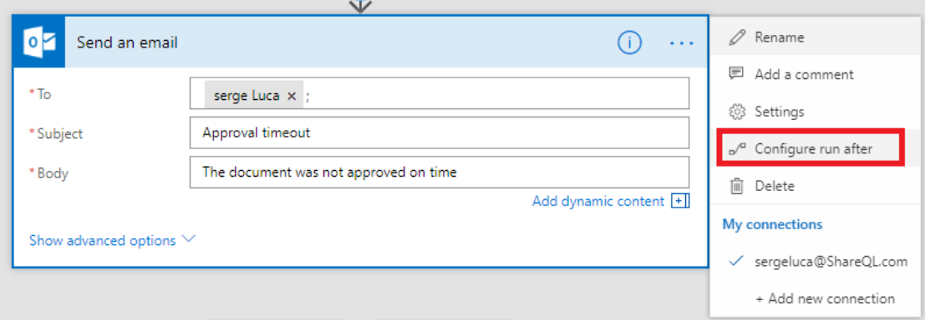
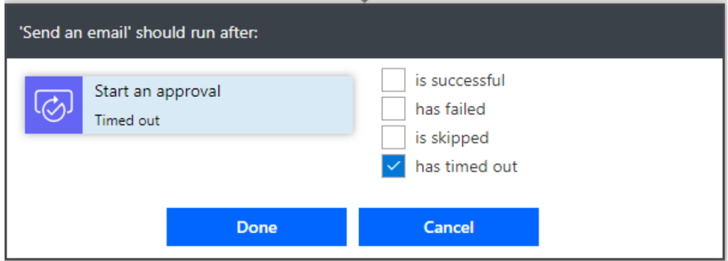
Error handling – use “Configure run after”
Flow run time is limited to 30 days
Sample flow: “Flow Training : Error Handling”

Slide 17
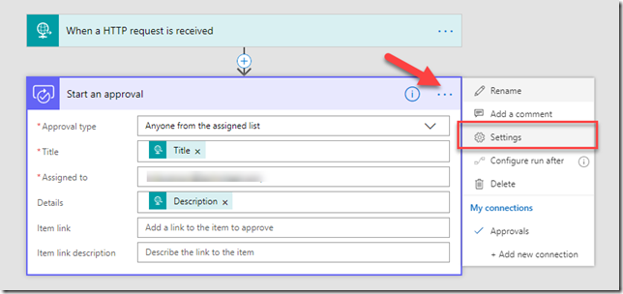
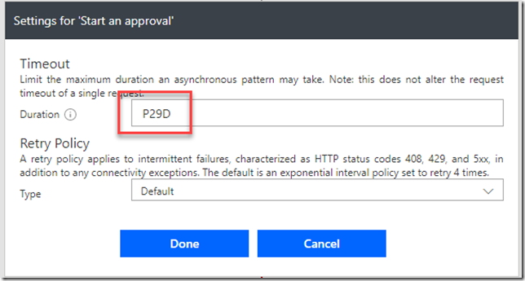
Error handling – Approval expiring
the default max timeout is 30 days in Microsoft Flow
But you can change the timeout
If you set the action timeout to 29 days it’s guaranteed to timeout before the whole flow times out. To test it out you can set the timeout lower, for example 15 minutes (PT15M).

Slide 18
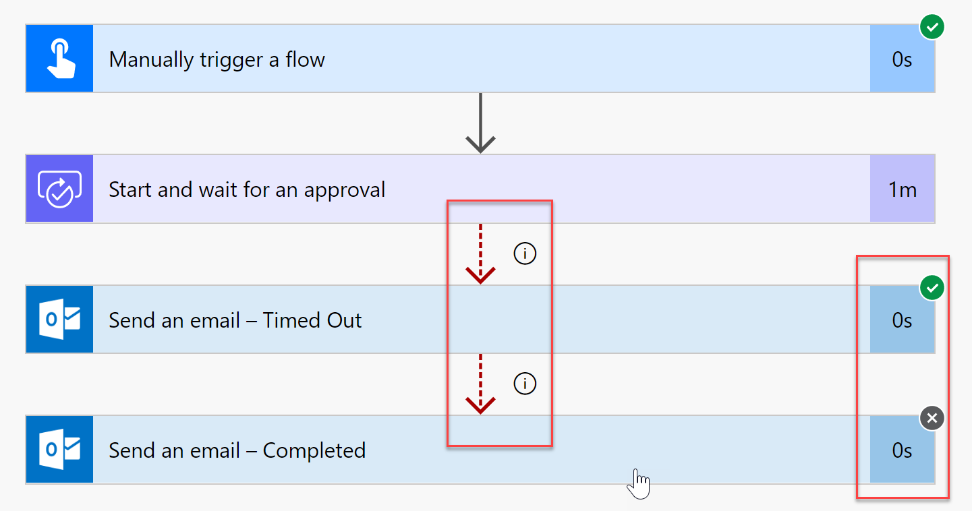
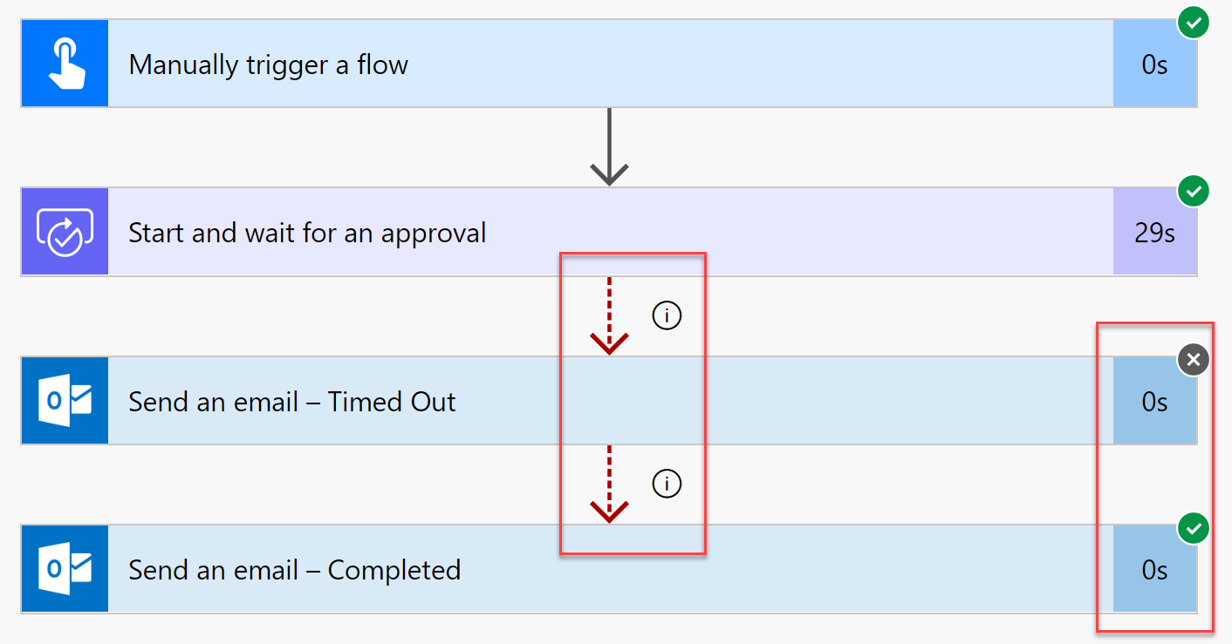
Error handling – Approval expiring

Slide 19
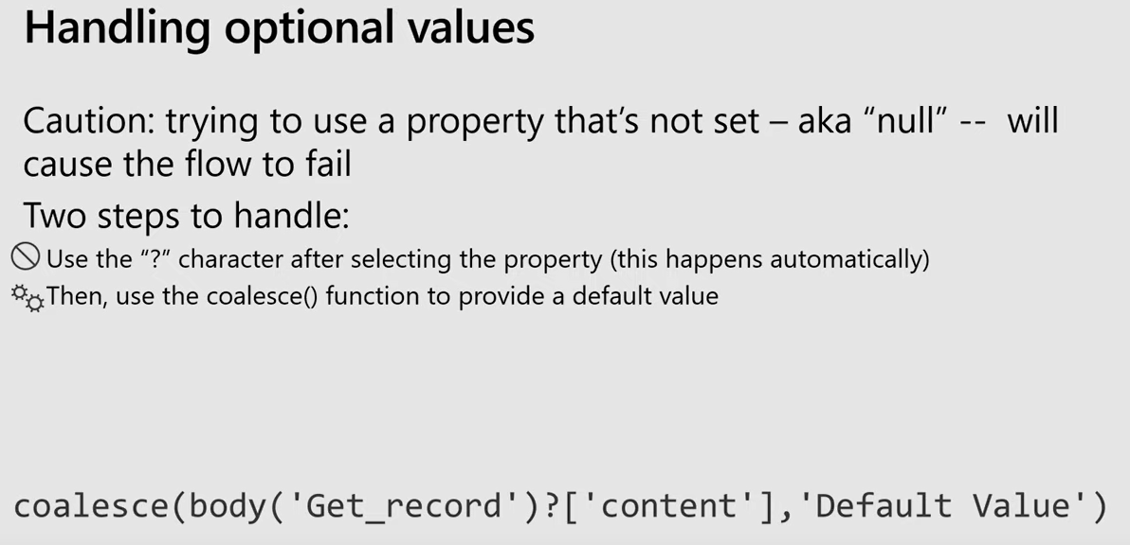
Optional values
Sample flow: “Flow Training : Error Handling”

Slide 20
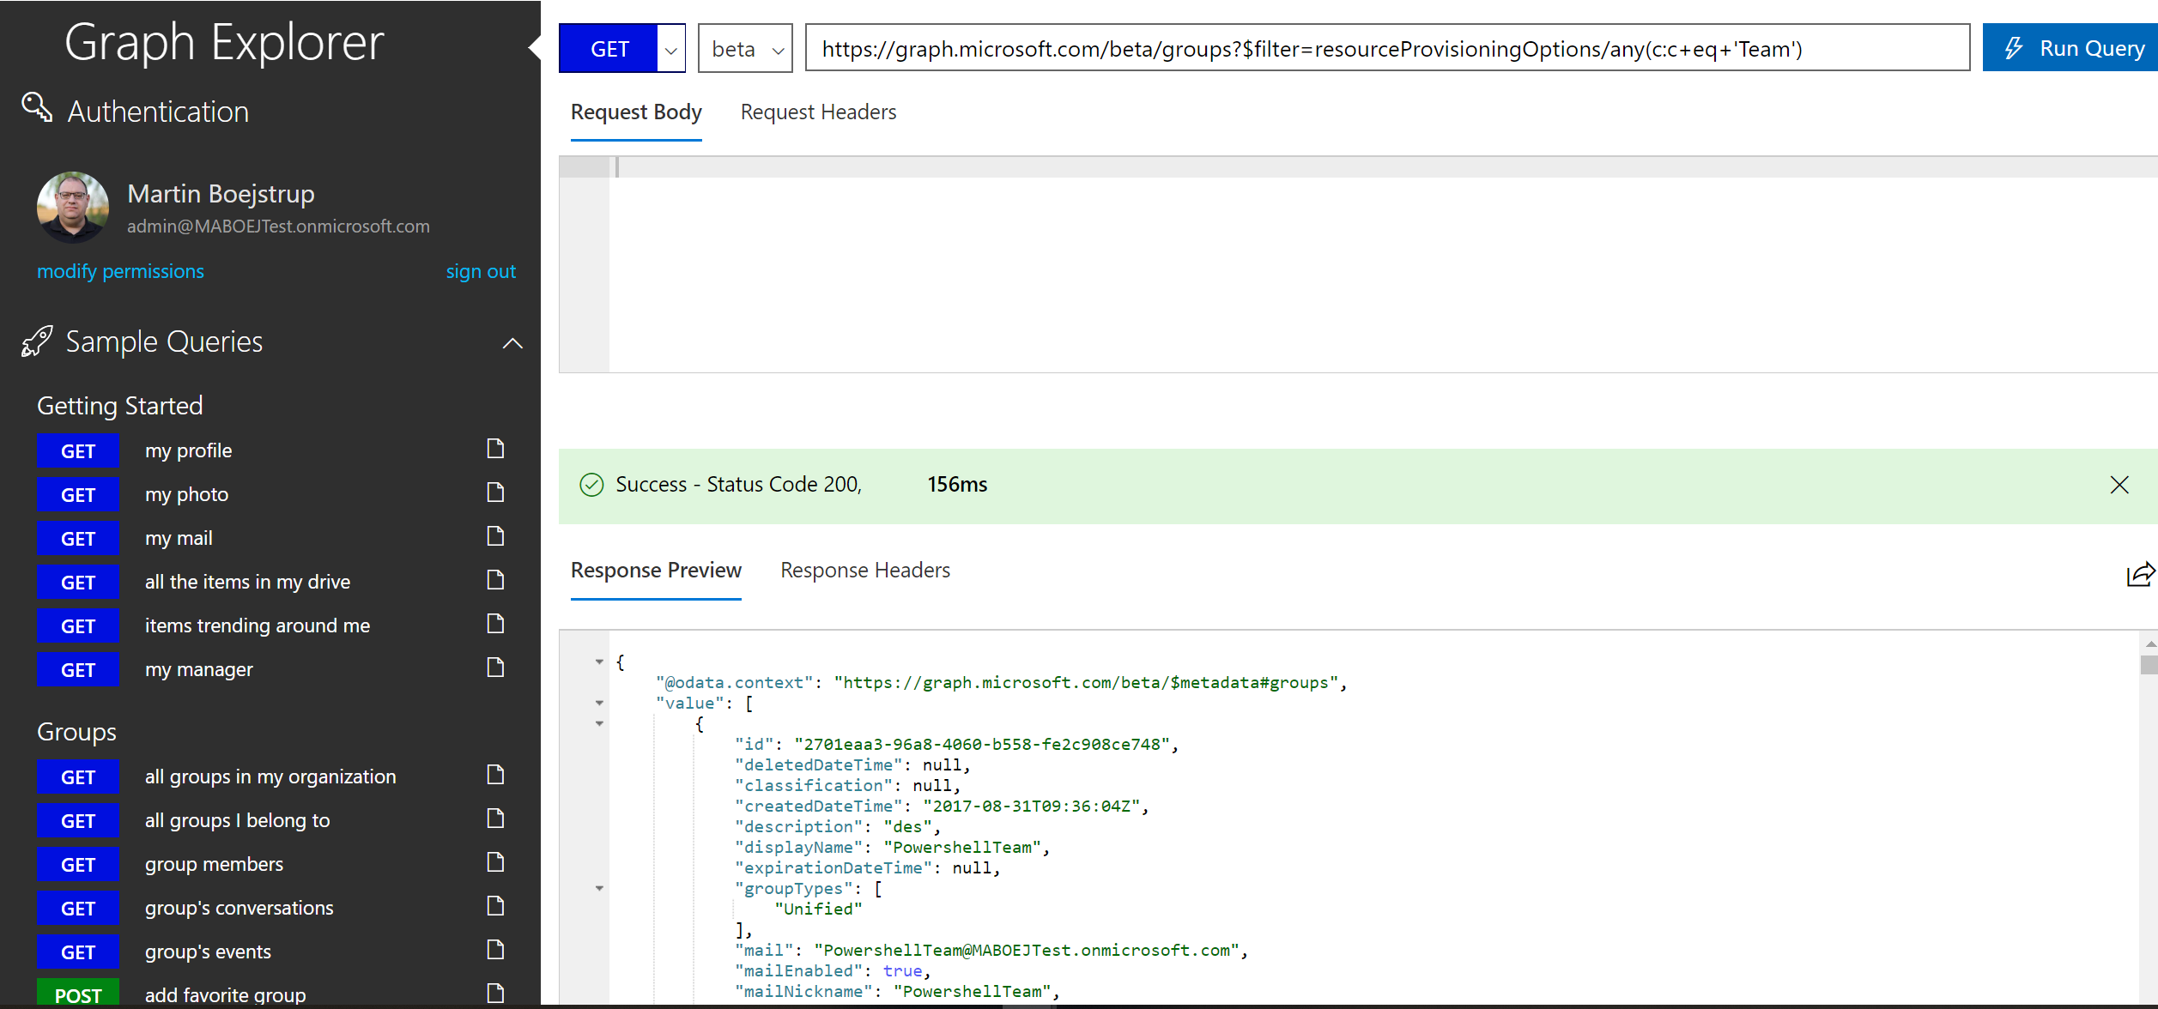
Working with Microsoft Graph
User Graph Explore to test – http://aka.ms/ge

Slide 21
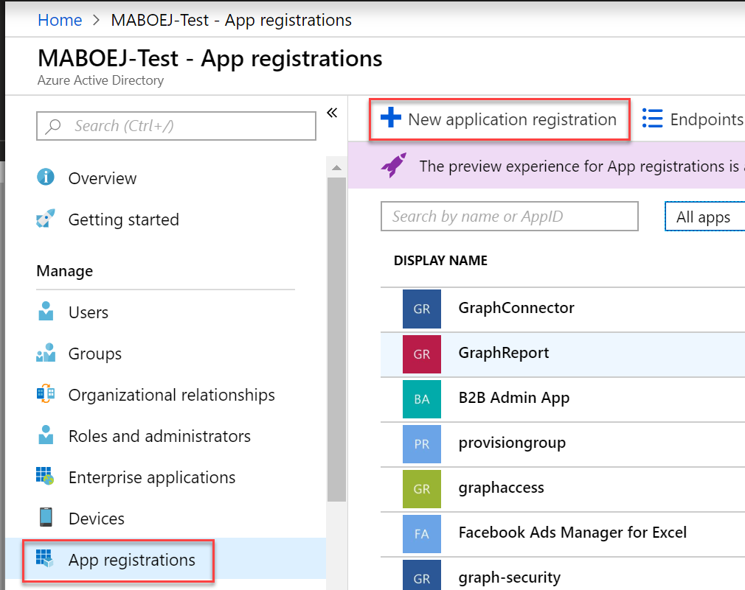
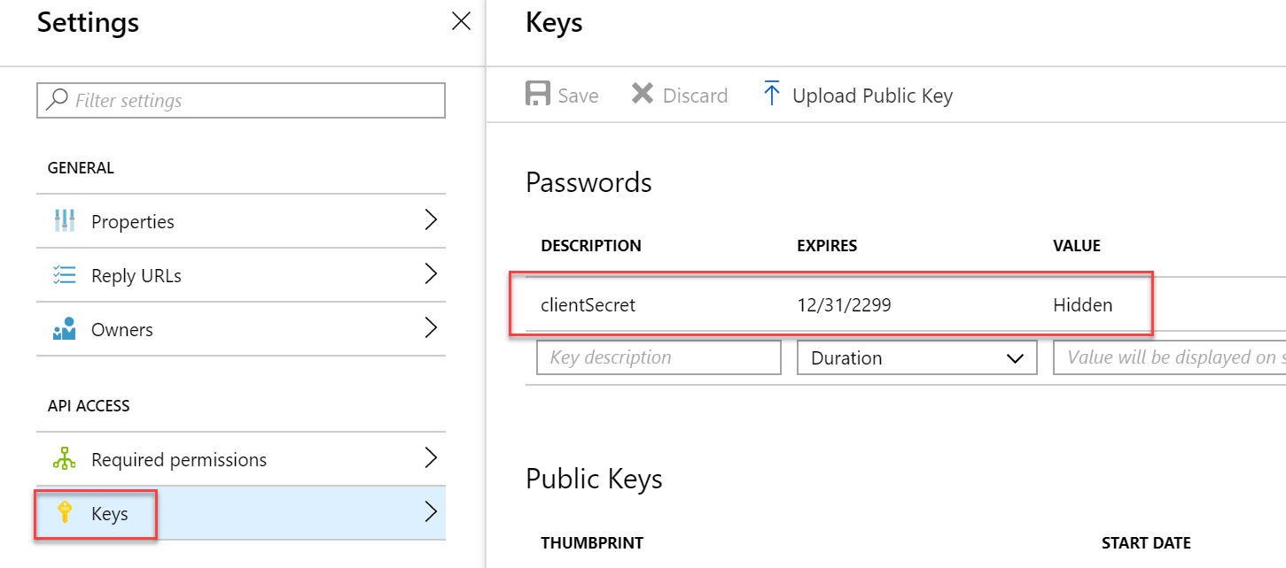
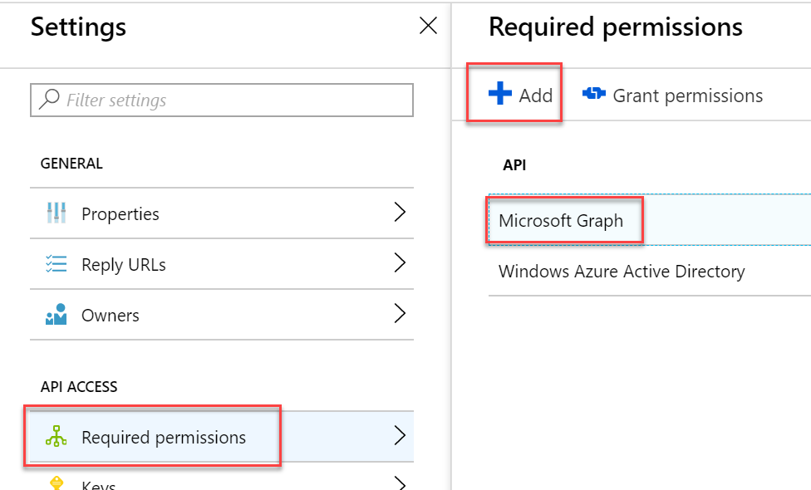
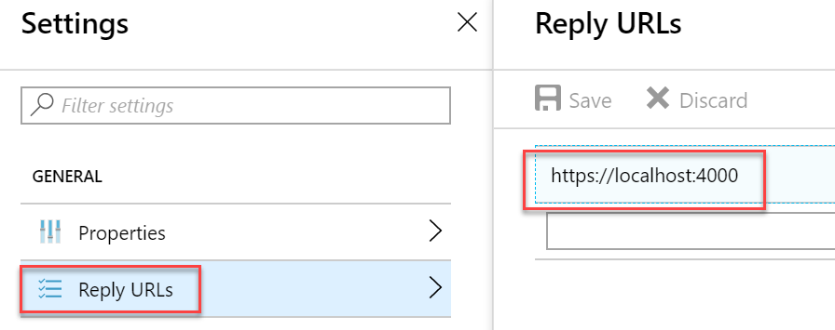
Working with Microsoft Graph
You need to create an App in Azure AD

Slide 22
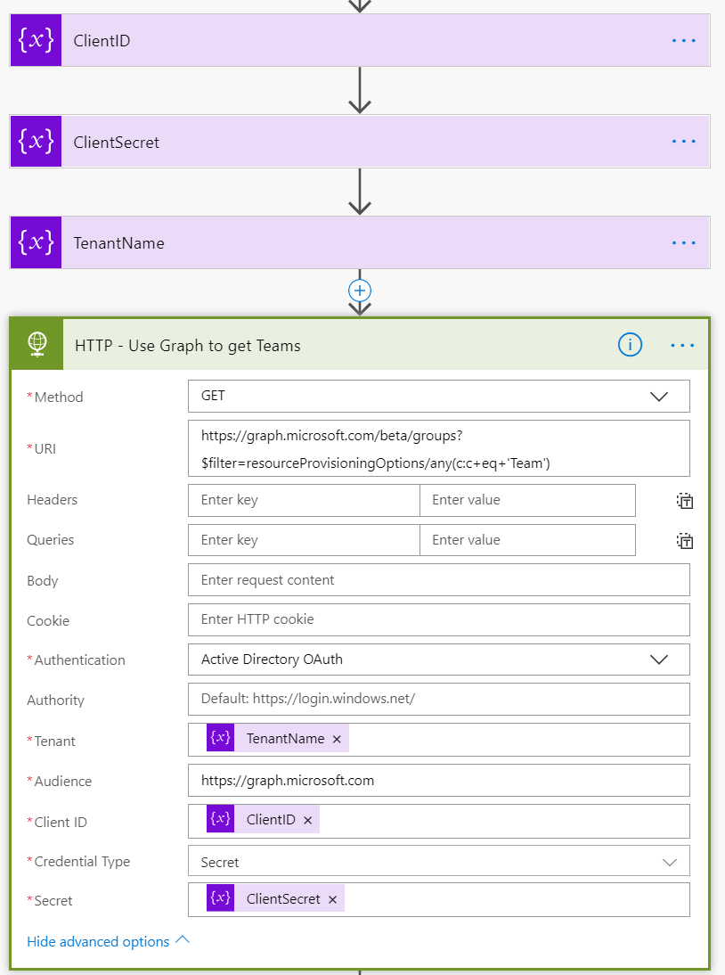
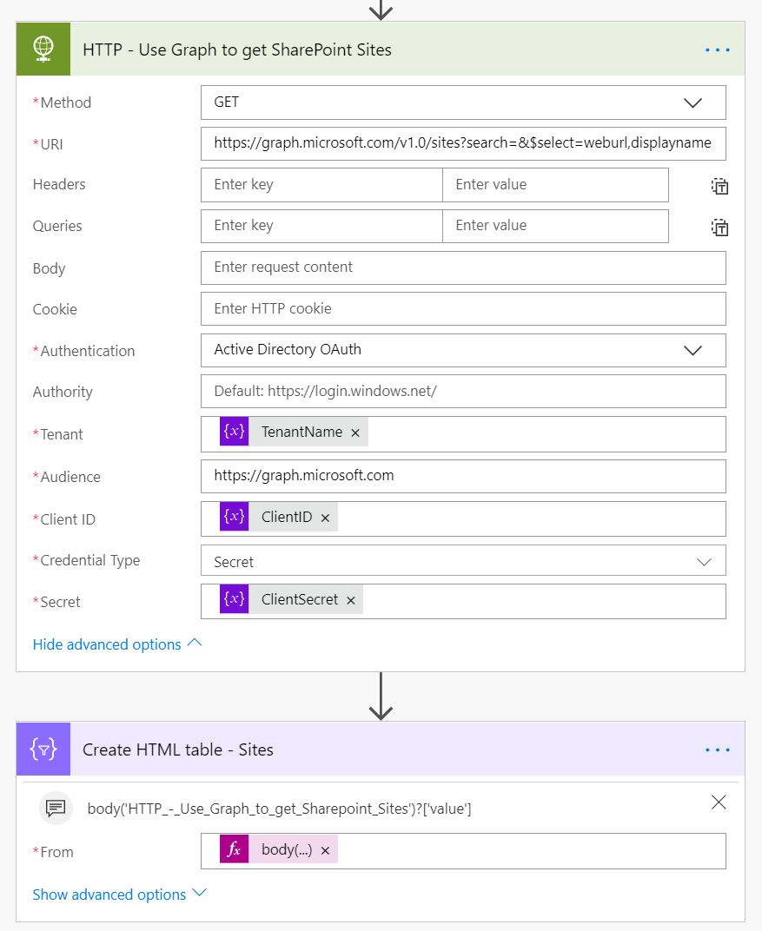
Working with Microsoft Graph

Slide 23
Working with Microsoft Graph
Get teams: https://graph.microsoft.com/beta/groups?$filter=resourceProvisioningOptions/any(c:c+eq+'Team’)
Search Groups:
https://graph.microsoft.com/v1.0/groups?$filter=startswith(displayName,'New’)
https://graph.microsoft.com/v1.0/groups?$filter=displayName eq 'new phones’
Get Sites:
https://graph.microsoft.com/v1.0/sites?search=
Search sites:
https://graph.microsoft.com/v1.0/sites?search=aaa222&$select=weburl,displayname

